Slide 1
Git Commands & Git Lifecycle
Presented By:- Abhisek Dhal
Emp ID:- 2587619

Slide 2
Objectives
Git
Git Features
Git Commands
Git Life Cycle
Summery

Slide 3
Git
Git is a Distribute version control system used for tracking changes in source code during software development.
It was created by Linus Torvalds in 2005 and has become the most widely used version control system in the world.
Git is open source and is designed to handle projects of all sizes.

Slide 4
Git Features
Compatible
Lightweight
Simple Design
Open Source
Secure
Easy to integrate
Can Handle Larger Projects

Slide 5
Git Basic Commands
git init [repo name]:- Create new repo at Specific Folder
cd [repo name]/:- To go inside the directory
ls -alrt:- Show all files available in a directory
touch <filename>:- Create a New File
git add <filename>:- Add that file into Staging Area
git rm <filename>: Remove File
git rm --cached<filename>: Remove file only from Staging area

Slide 6
Git Basic Commands
git status:- To see the Condition of Files
git commit -m ‘comment’:- Git Commit Command
git log:- To View Commit History
git log -p -<number of commit>:- See Specific Number of Commit
git show:- Get information of commit
git config:- To configure git
git config --global --list:- To access the global Configuration

Slide 7
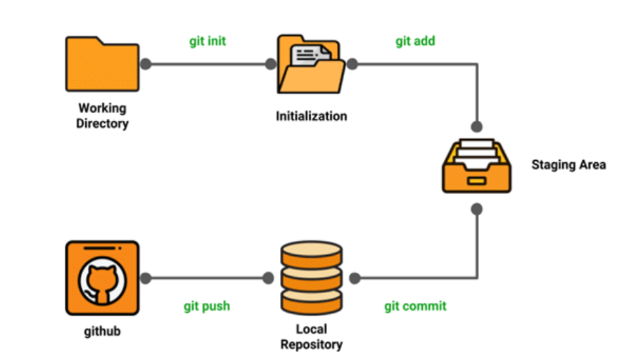
Git Life Cycle
The Git lifecycle represents the process of managing changes to files within a Git repository.
Refers to the Below Diagram:

Slide 8
Summery
Here we came to know about Git, Git Features, Git Initialization,working with git commands and the Git Life Cycle
We've explored, the Git life cycle involves key stages such as the Working Directory, Staging Area, and Repository.

Slide 9


